Slide 1

SRI BHARATHI WOMEN’S ARTS and science college KUNNATHUR,ARNI-632 326

Slide 2
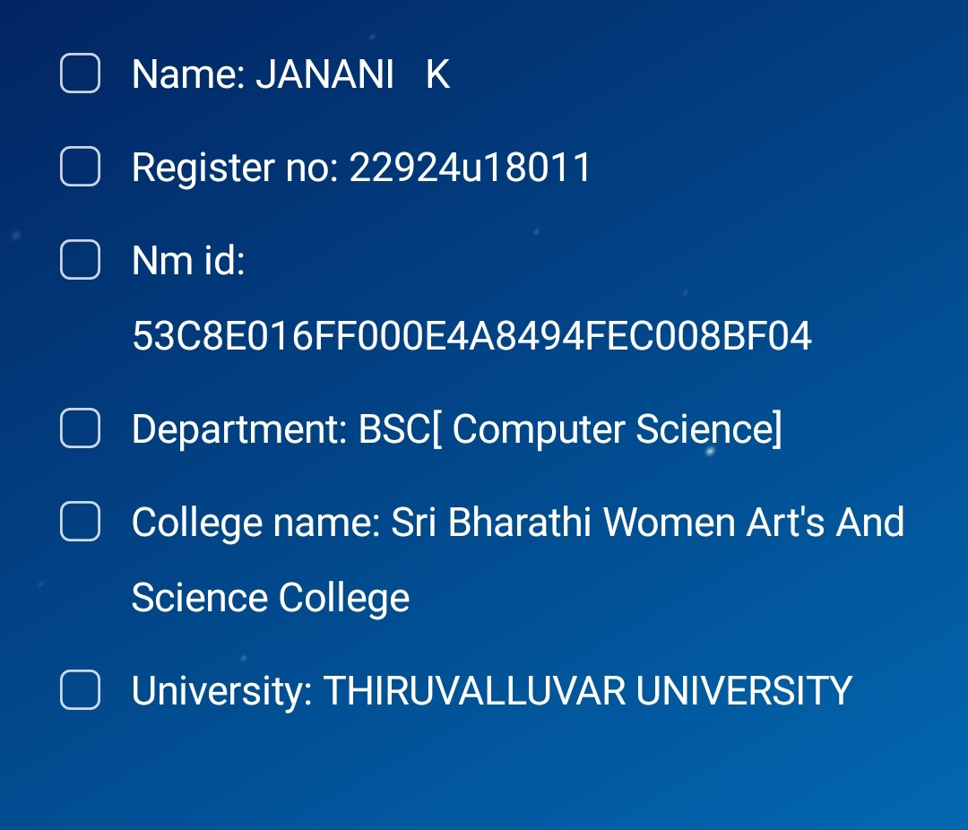

Slide 3
FINGER PRINT BASED ON AUTHENTICATION

Slide 4
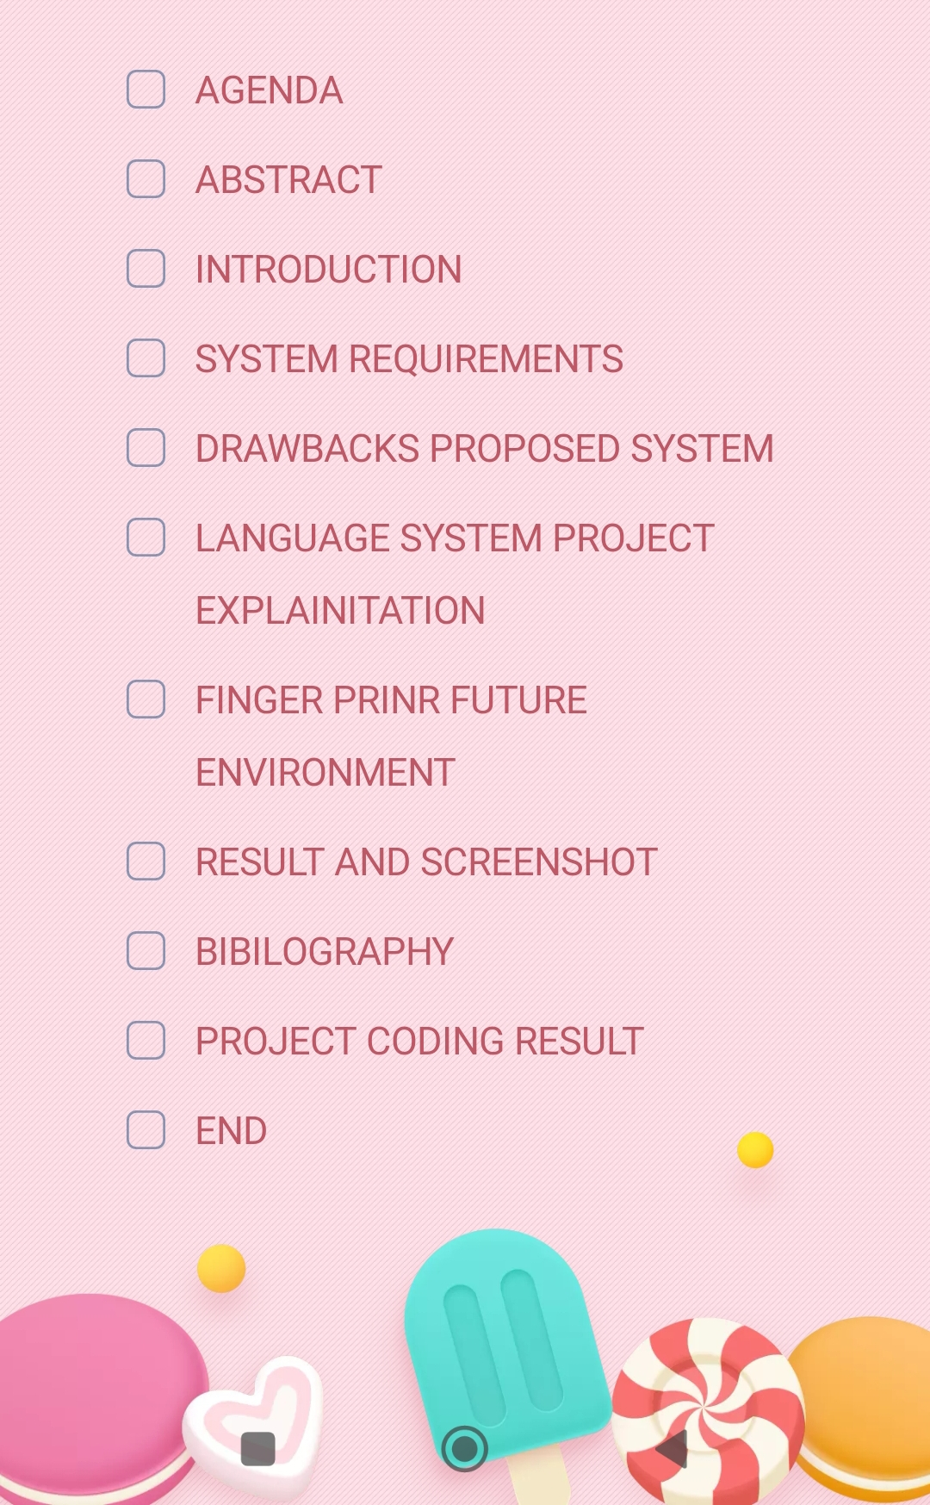

Slide 5
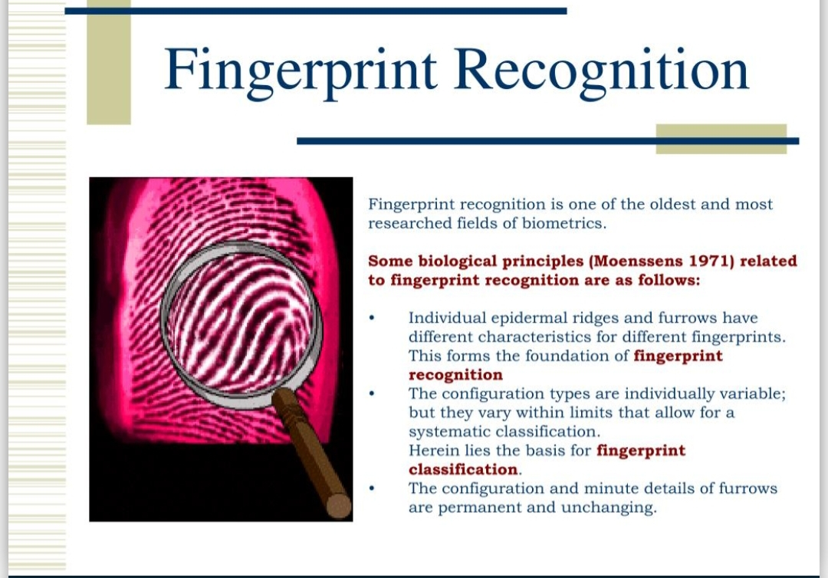

Slide 6
ABSTACT
This biometrics project focuses on fingerprint recognition and how such a system would be implemented. If implemented in our laboratory, this system would confirm or deny the identity of each individual attempting to gain access to the lab area with a given amount of precision. The scanner that will be used in this project is the Microsoft Fingerprint Reader. The primary problem in using this particular scanner comes from the security features Microsoft incorporates. The signal caring all the information from the fingerprint scan is encrypted, and the biggest challenge will come from deciphering this signal. Another major challenge of this project will be understanding the methods used to analyze the information from the scan. There are several different methods including Fourier Exponential Series and Principle Component Analysis, but cutting edge systems rely on information stored with wavelets to analyze and compare scans. If this project is a success, the lab will benefit from the security and understanding of modern fingerprint recognition.

Slide 7
INTRODUCTION
➢ The current world is distressed due to the problem of Authenticity. There are few authenticating techniques used for authentication purpose.
➢ Few techniques are password or PIN, retina scans of fingerprint based authentication. Thought these techniques are not very effective, our Application will be more effective for providing authentication for the user.
➢ Our application was built on DOT net platform. The C# has a base class called Microsoft Foundation Class which has all function which is already tested by Microsoft. The signature is stored in Microsoft SQL Server 2000 database.
➢ Our application provides authentication by checking the signature with the Stroke. When the stroke in the signature changes the user authenticity will be cancelled. In our application we can strengthen the security by decreasing the error percentage.

Slide 8
SYSTEM REQUIREMENTS
HARDWARE REQUIREMENTS:
The project development is carried out in the following hardware
➢ Processor : Pentium IV
➢ Memory : 128 MB RAM
➢ Hard Disk :40GB
➢ Mouse :Logitech
➢ Monitor :15 VGA Colour
SOFTWARE REQUIREMENTS :
The project development is carried out in the Microsoft Development
➢ Operating System : Windows XP,7&8
➢ Platform : DOT NET Frame Work
➢ Language : C#
➢ Backend : Microsoft SQL Server 2003

Slide 9
EXISTING SYSTEM
➢ Currently the viable authentication mechanisms is use are password or PIN based. A user wishers to be authenticated enters a short string or a number which is supposedly easy to remember, but is easy to forget and the authenticating machine checks the hash of the password against a stored hash in a database.
➢ If a user were to forget his or her password or it was stolen by someone wishing to steal the user’s identities of the user becomes endangered and easy to compromise.
➢ A common solution to the problem is to implement a biometric authentication mechanism such as retina scans or fingerprint based authentication. The advantage of this a retina or a fingerprint cannot be forgotten and it is unique to each user.
➢ While such a system us extremely difficult to compromise, the cost implementation restricts its development. In addition, if such biometric data was in fact compromised, the result would be disastrous for the user- he or she cannot change fingerprints or retinas.
➢ To solve both the problems of password based authentication (relatively easy to compromise, easy to forget) and biometric authentication (expensive, intrusive, and disastrous if compromised) we attempt to solve the problem of user authentication via Handwritten Signature Verification (HSV).
➢ The hardware necessary for HSV inexpensive and already widely deployed in (E.g. credit card machines in stores, tablet PCs)

Slide 10
DRAWBACKS IN EXISTING SYSYTEMS
➢ The user will forget the pin number or password or its can be easily stolen.
➢ Retina scan, fingerprint based authentication are expensive.
➢ A signature is verified manually with the scanned images.
➢ Since the customer details and the signature are stored in a separate file it takes much time to store or retrieve the signature corresponding to the customer details.

Slide 11
PROPOSED SYSTEM
➢ The system proposed to solve both the problem of password based authentication and biometric authentication is via Signature Verification Using Back Propagation. The hardware necessary for signature verification is inexpensive and it can be deployed in (E.g. credit card machines in stores, tablet PCs, ATM machine).
➢ The system is proposed to overcome authenticating problem in signature verification with the help of Back propagation Algorithm. Any person in this world can never sign a same signature every time in their life time. His/her signature will be differing from time to time.
➢ When the user is in a calm mood the signature will be very different than the signature of the same user in a hurry or in a bad mood. So to overcome this problem Back propagation Algorithm this is one of the best neural network techniques to train the artificial neuron to recognize the different type of signature of same user.
➢ If the neurons are fine tuned they can provide us the best authentication security. The different signatures of the same user act as the knowledge base for the verification.
➢ Entire project is presented in the modular forms. Therefore each module can be reused for further developments as well as for some other applications.
• Signature is verified systematically by image processing methods.
• Thumb prints, finger prints and photo can also be scanned

Slide 12
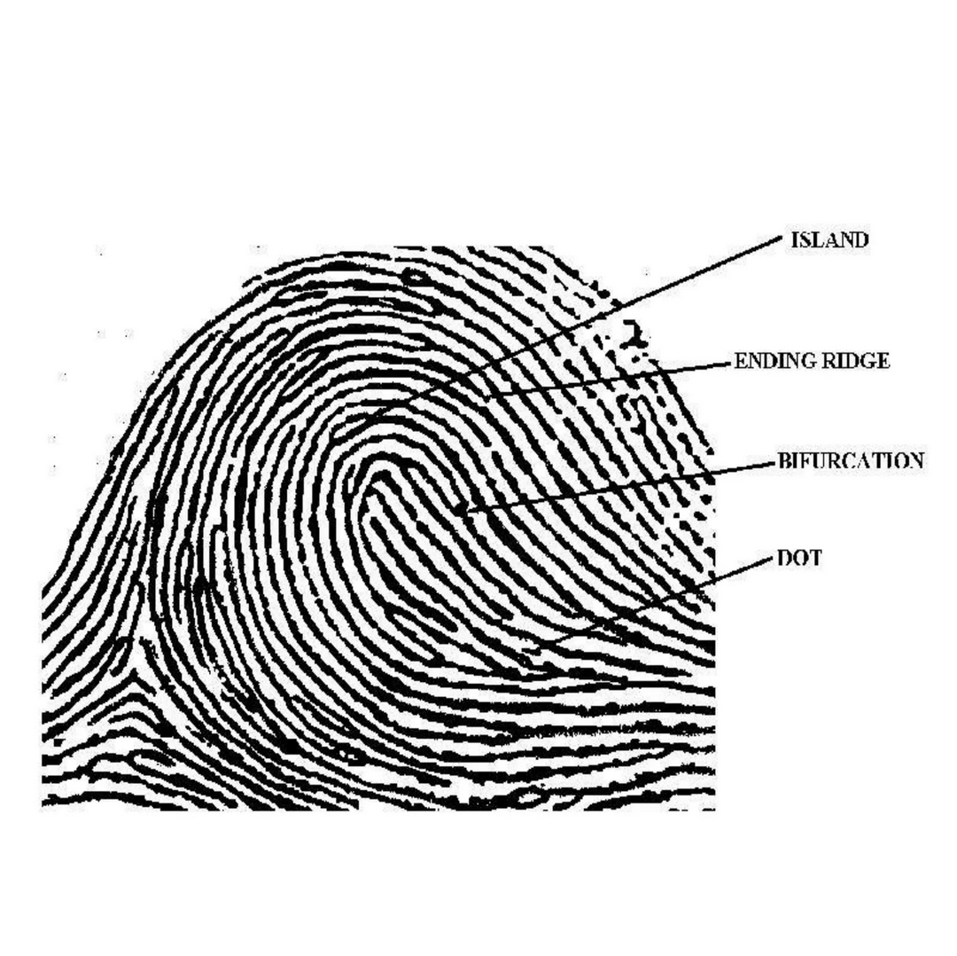

Slide 13
LANGUAGE DETAILS
➢ The developing tools in C# DOT net including the Integrated Development Environment (IDE), C# complier, and class library-the Microsoft Foundation Classes (MFC). The IDE includes an Application Wizard and testing features. The MFC productivity since it holds common Windows code in classes that are already tested.
➢ At the simplest level, C# can be considered a C# complier since it allows compiling, debugging, and extending of code. At a higher level, the use of C# DOT net in development services and application can accelerate programming speed. Microsoft Visual C# DOT net has always been one of the most comprehensive and sophisticated software development environment available.
➢ It has consistently provided a high-level of programming power and convenience, while offering a diverse set of tools designed to suit almost every programming style. And Visual C# DOT net adds significantly to the already impressive array of features.

Slide 14
PROJECT EXPLANATION
➢ This system is developed to overcome authenticating problem in signature verification with the help of Back propagation Algorithm. Any person in this world can never sign a same signature every time in their life time.
➢ His/her signature will different than the signature of the same user in a hurry or in a bad mood.
➢ So to overcome this problem Back propagation Algorithm this is one of the best neural network techniques to train the artificial neuron to recognize the different type of signature of same person

Slide 15
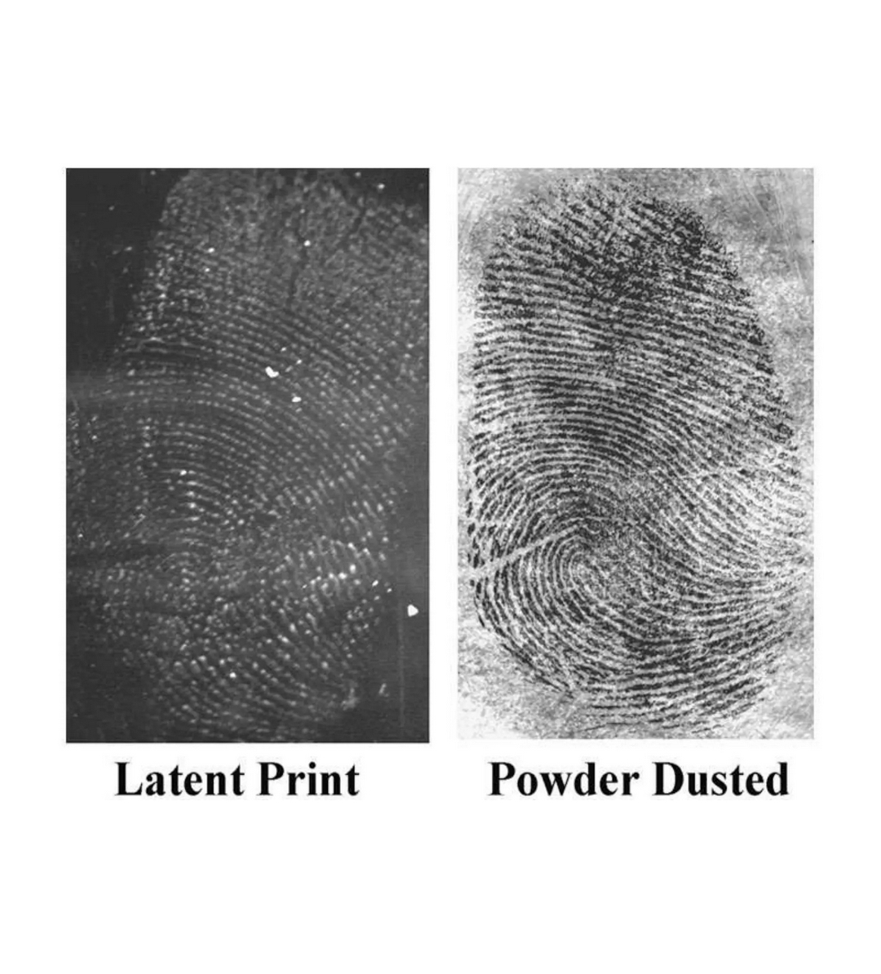

Slide 16
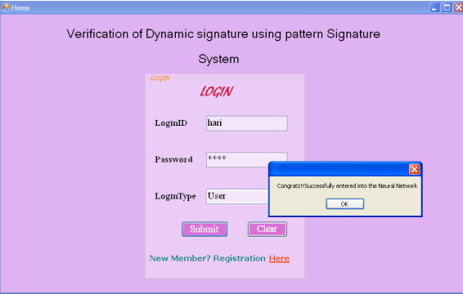
screenshot

Slide 17
CONCLUSION
❖ The project is done for maintaining the security measures in a banking transaction. We have introduced some of the techniques that can be professionally used to produce quality in the security. The entire project is presented in a modular form and therefore all the modules can be easily reused for future development as well as foe some other application.
❖ Though it is concentrated on the basics of programming with twain API, database, Back propagation algorithm and bitmaps, these techniques can e reused for development of other application with resemblance or using the concepts related to the above.
❖ This system is useful for any kind of application related to security if the signatures, photos, thumb prints, fingered prints are to be scanned and stored relevant to the customer

Slide 18
FUTURE ENVIRONMENT
❖ The images are scanned by using the BMF. In future it can be performed using GIF and JPEG format.
❖ This system can be fine tuned to recognize the hand written character by using neural network
❖ Software can be modified as Web Based Application.
❖ Developing the application in internet also possible

Slide 19
BIBILOGRAPHY
Mario Amelung. Web-Services für das E-Assessment. PhD thesis, Otto-vonGuericke-Universität Magdeburg, Magdeburg, in progress.
R. A. Avner and Paul Tenczar. The TUTOR manual. CERL Report X-4, University of Illinois, Urbana, IL, 1969. ERIC ED050583.
[Online] http://msdn2.microsoft.com/en-us/library/ms827819.asxp From MSDN website
[Online] http://www.herdsoft.com From herd soft website
[Online] http://en.wikipedia.org/wiki/microsoft_foundation_classes From wikipedia website

Slide 20
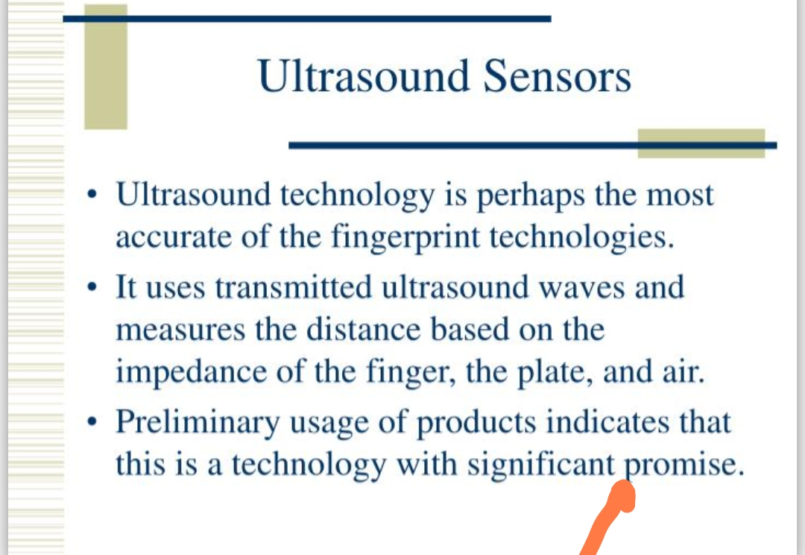
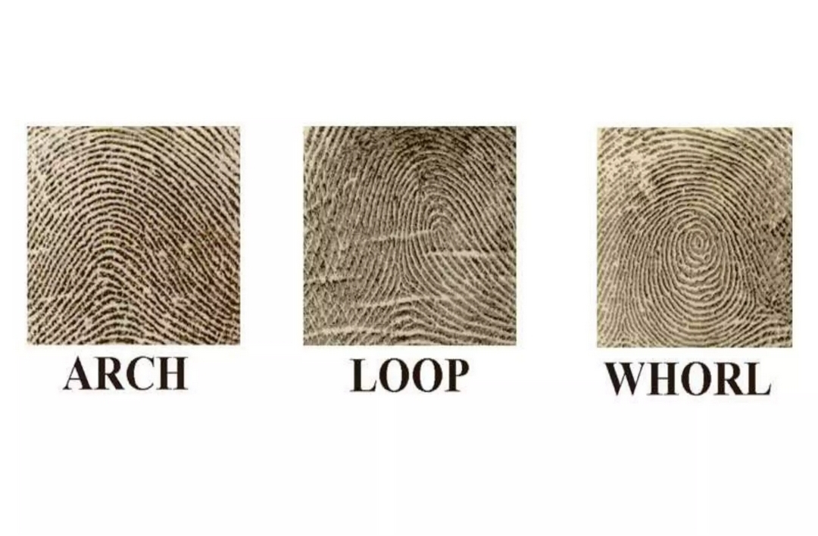
ANY QUERIES ?

Slide 21
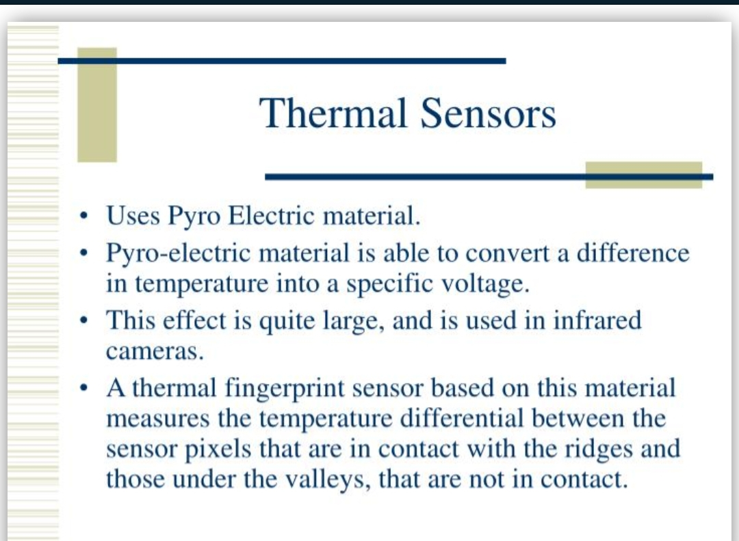

Slide 22
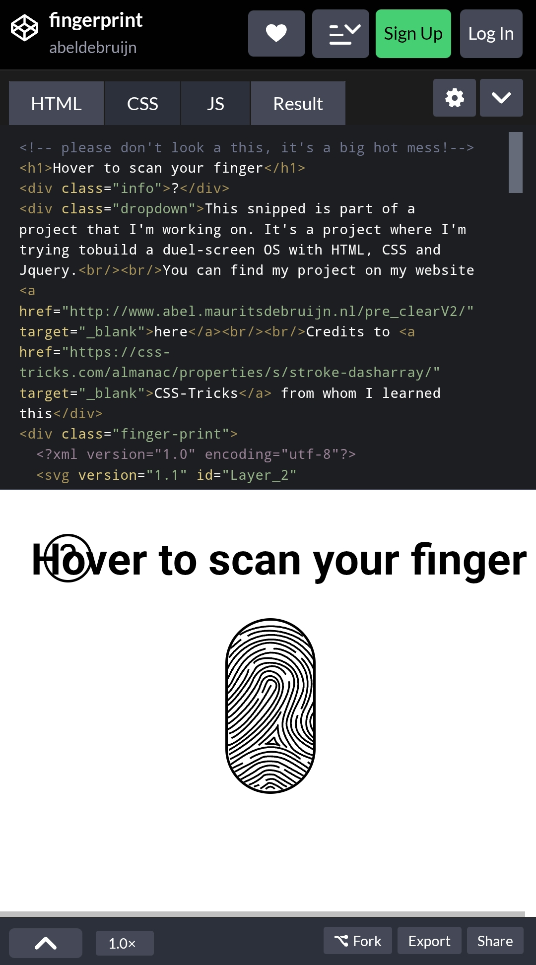

Slide 23
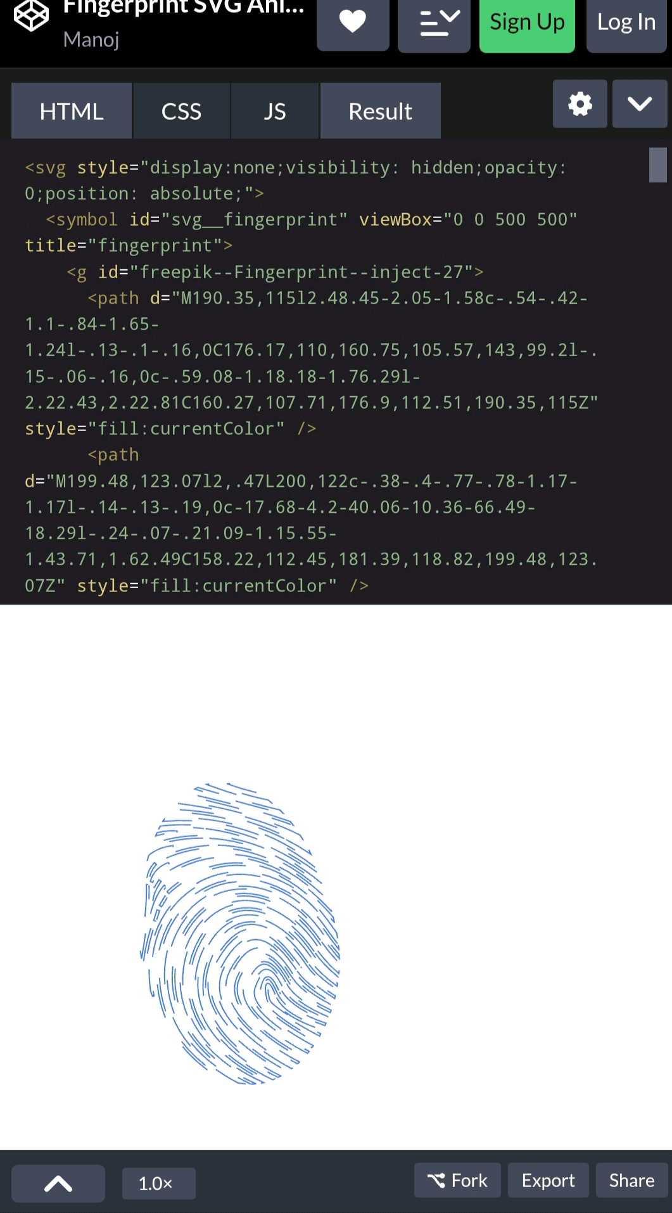

Slide 24
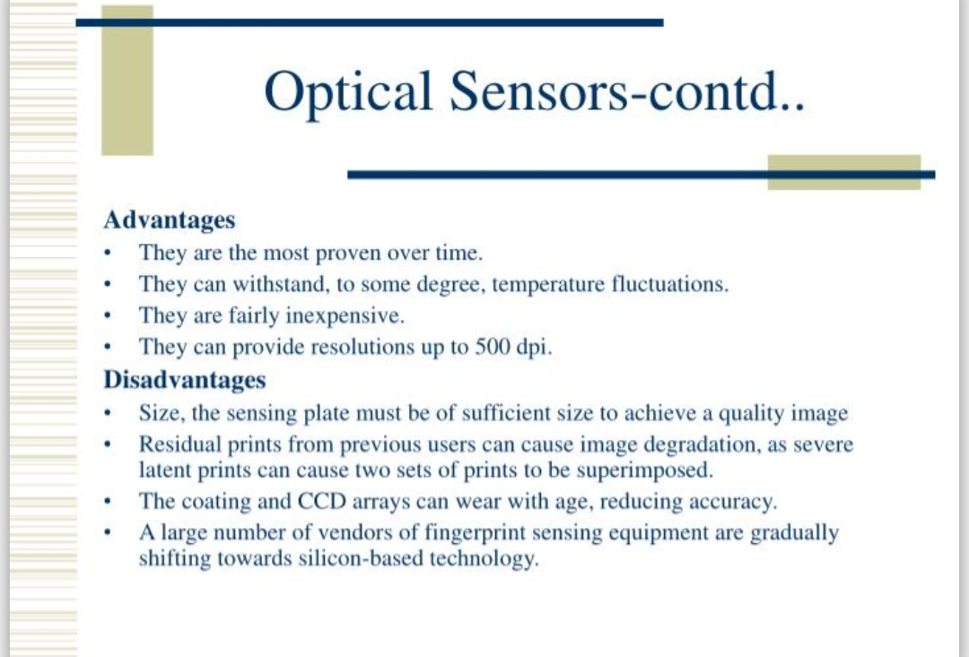
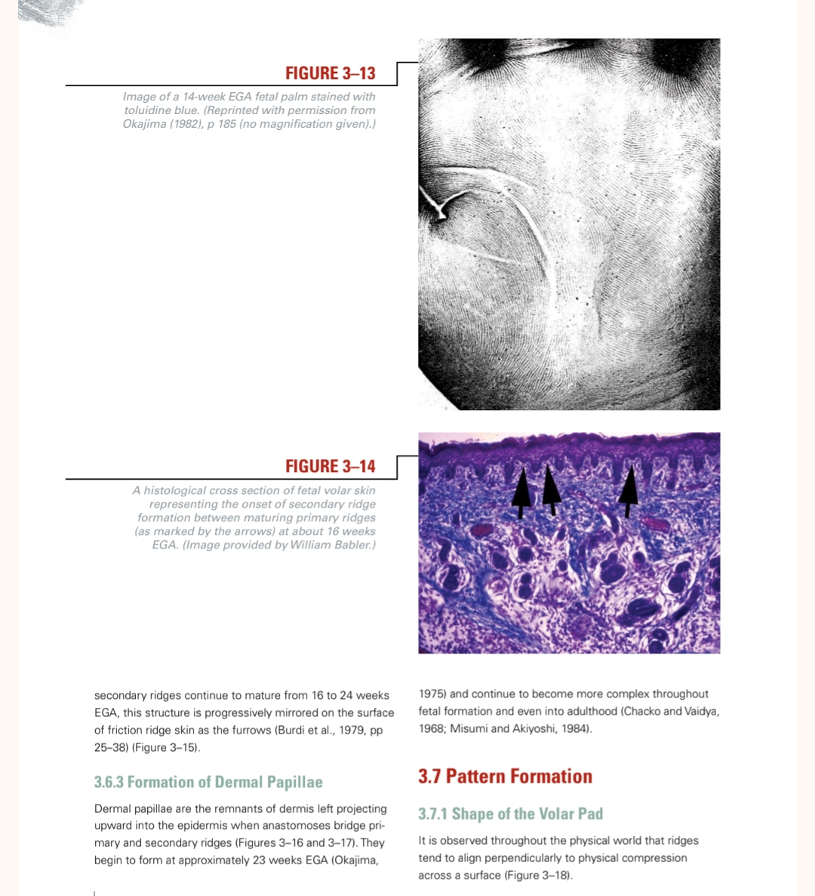

Slide 25
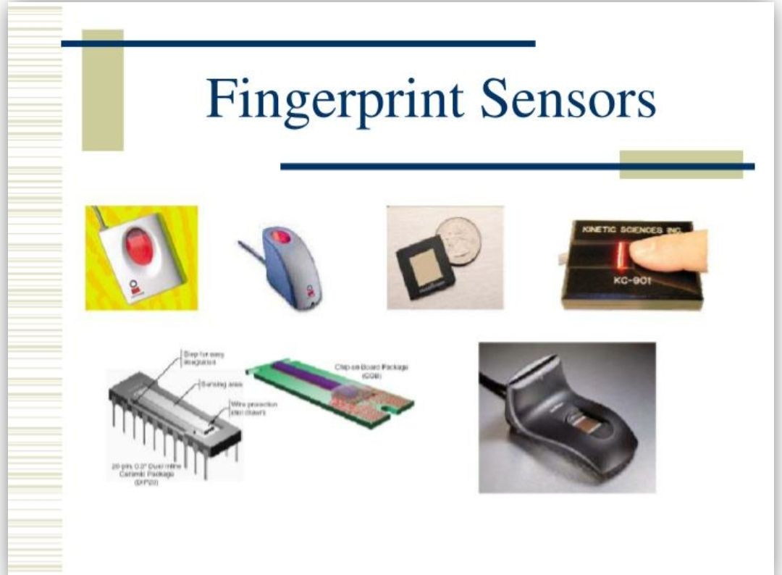
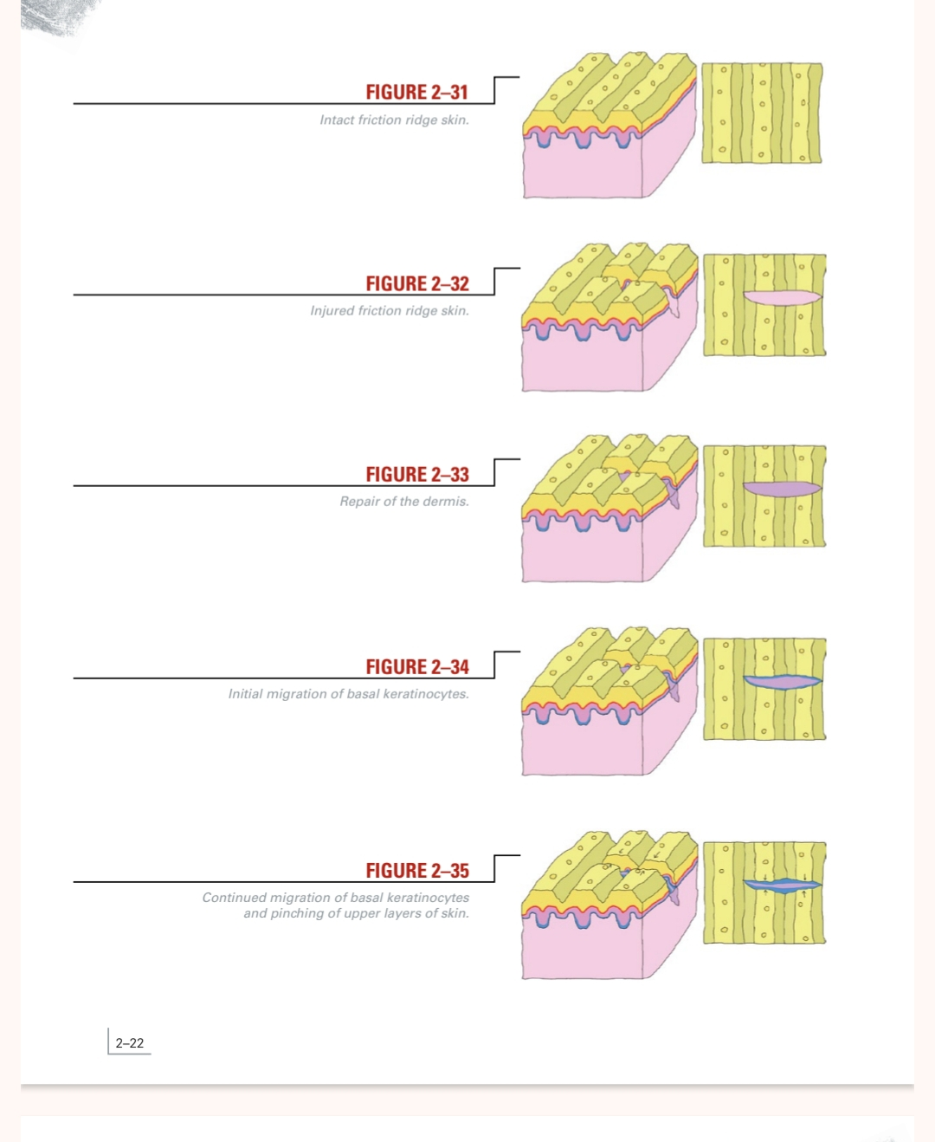

Slide 26
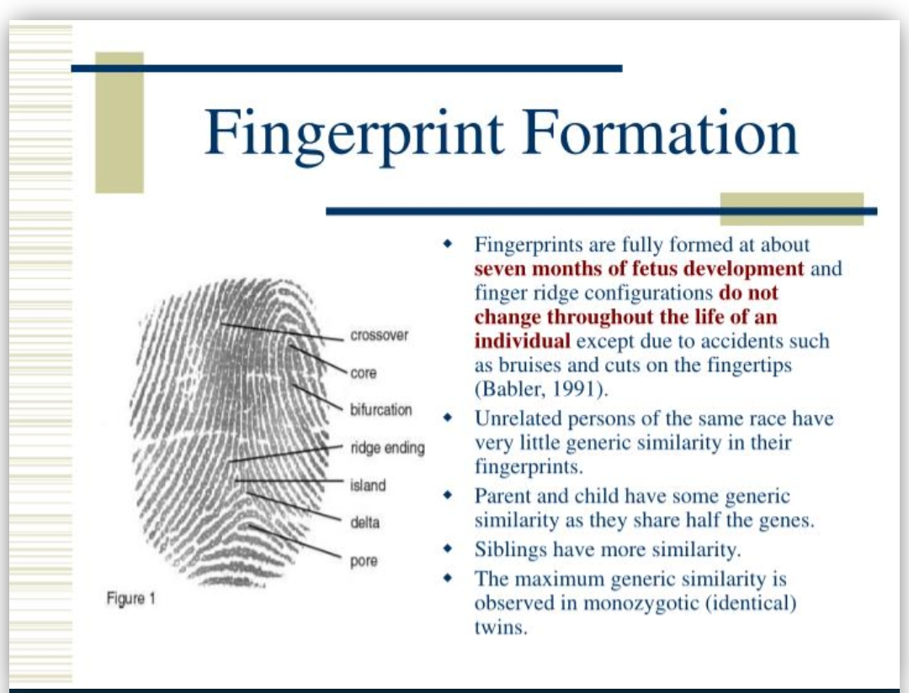
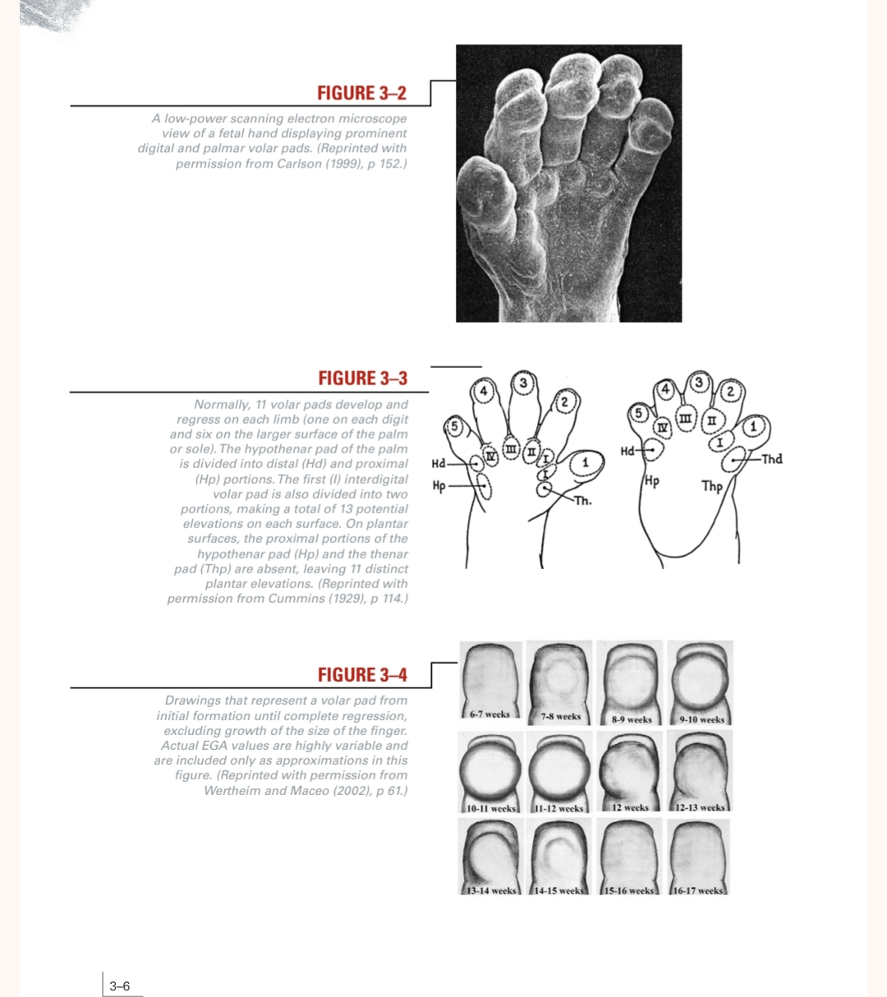

Slide 27
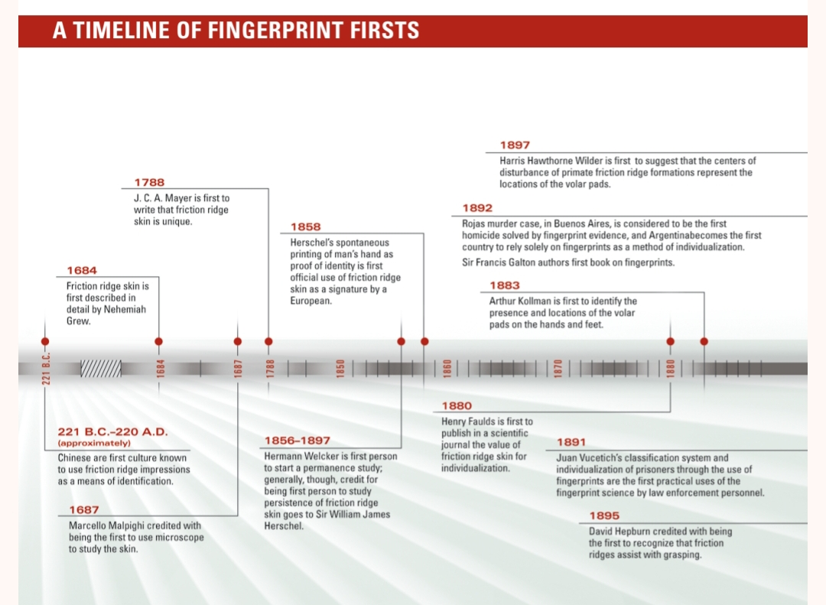

Slide 28
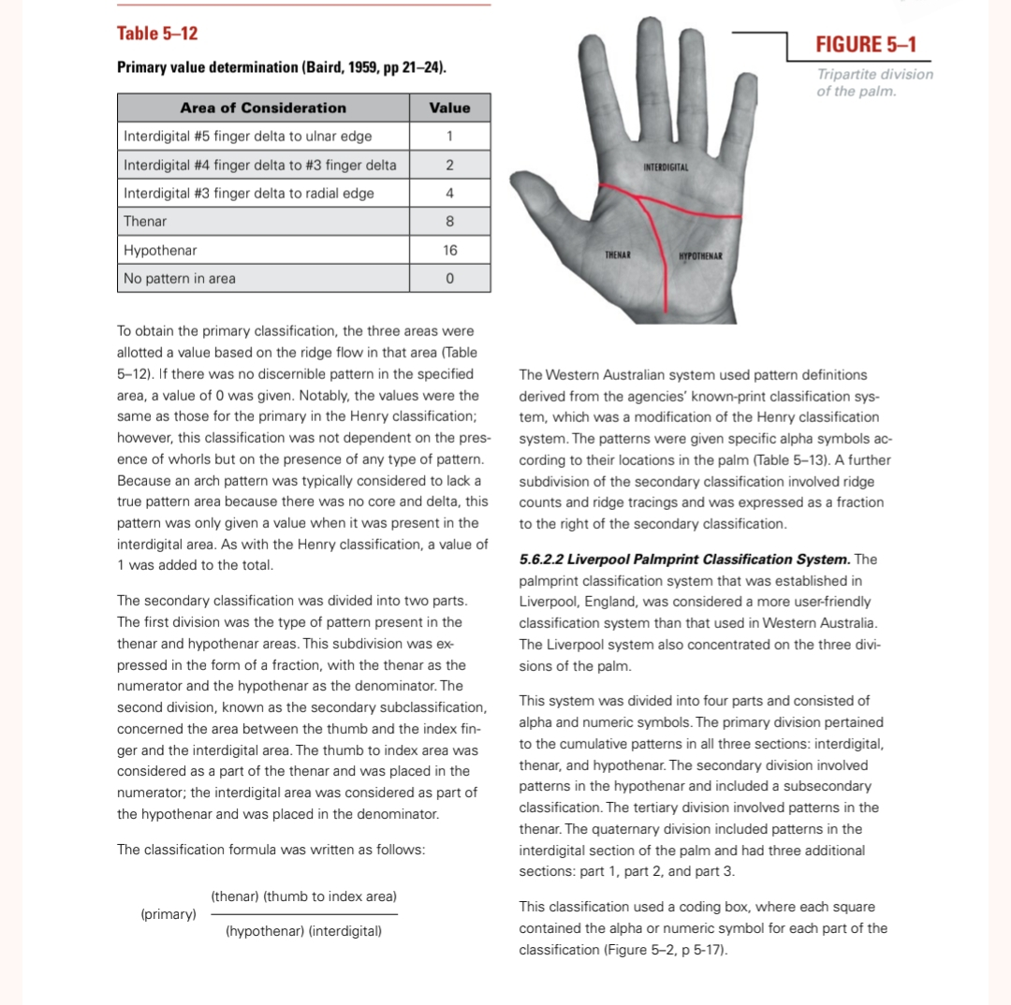

Slide 29
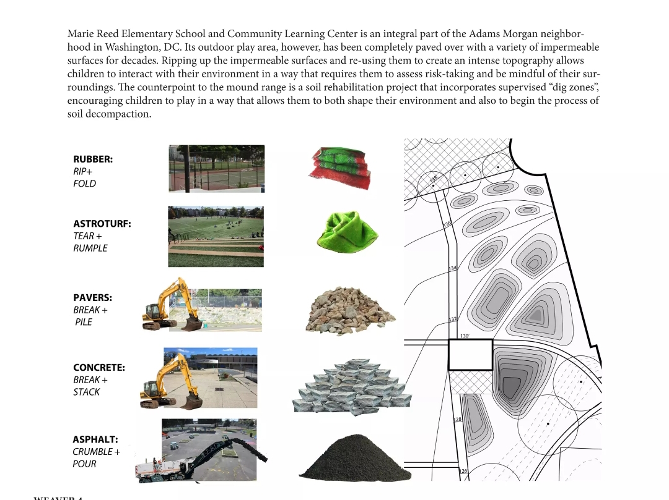

Slide 30
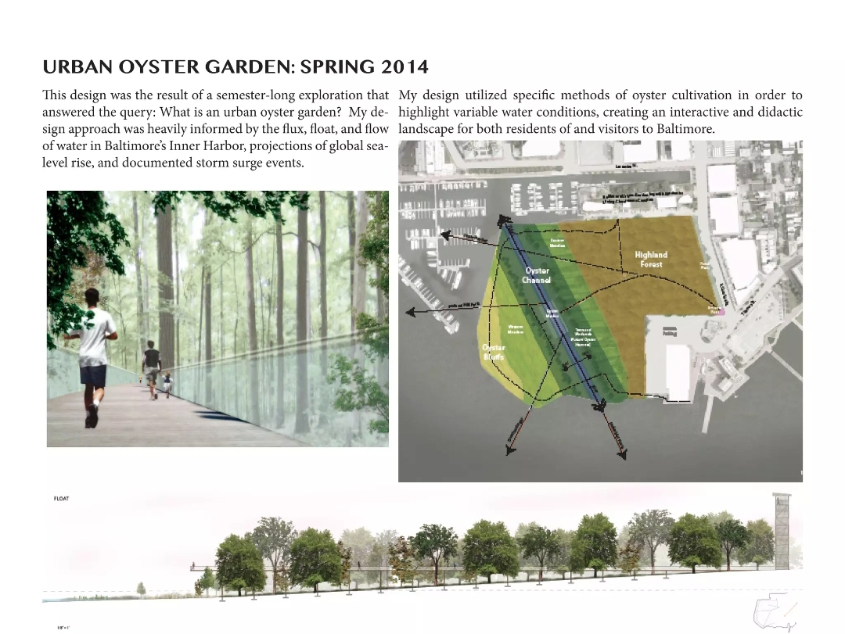
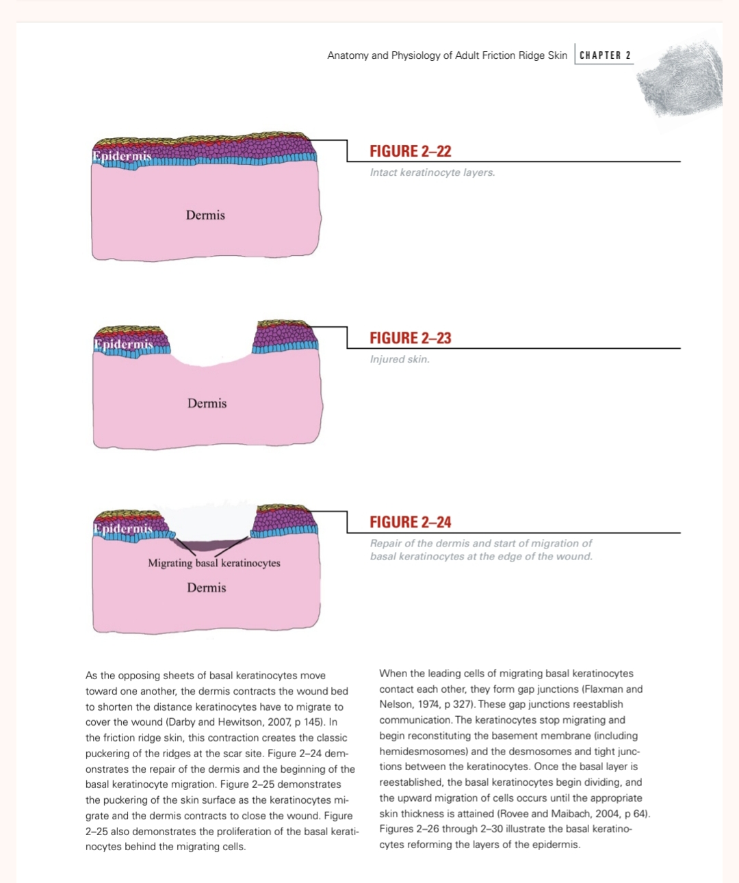

Slide 31
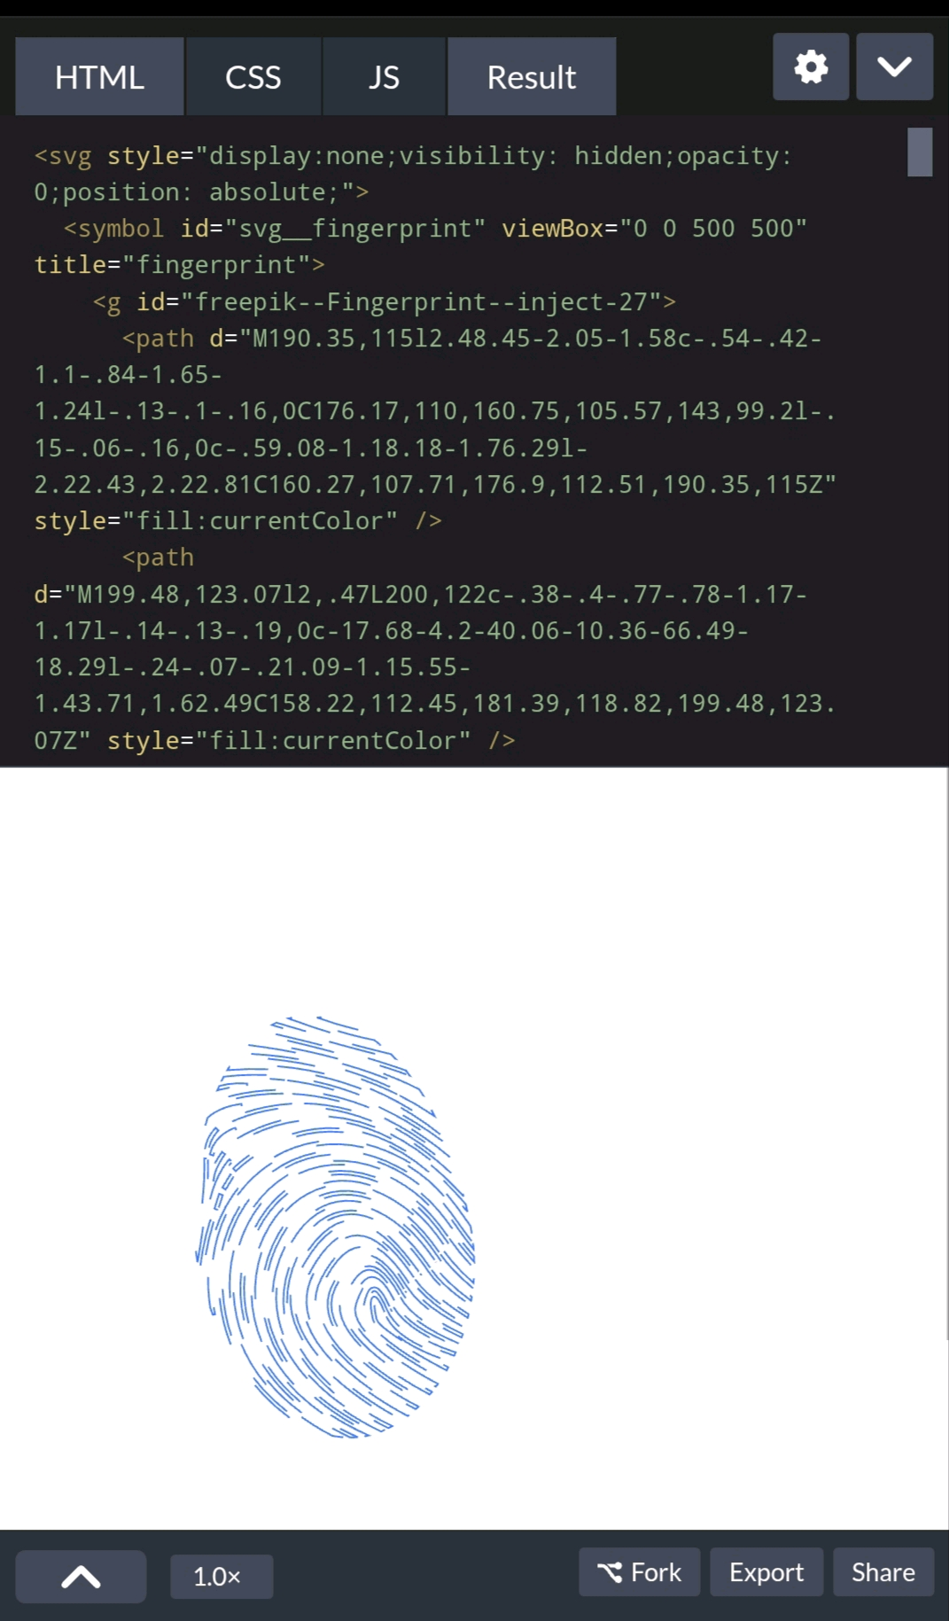

Slide 32
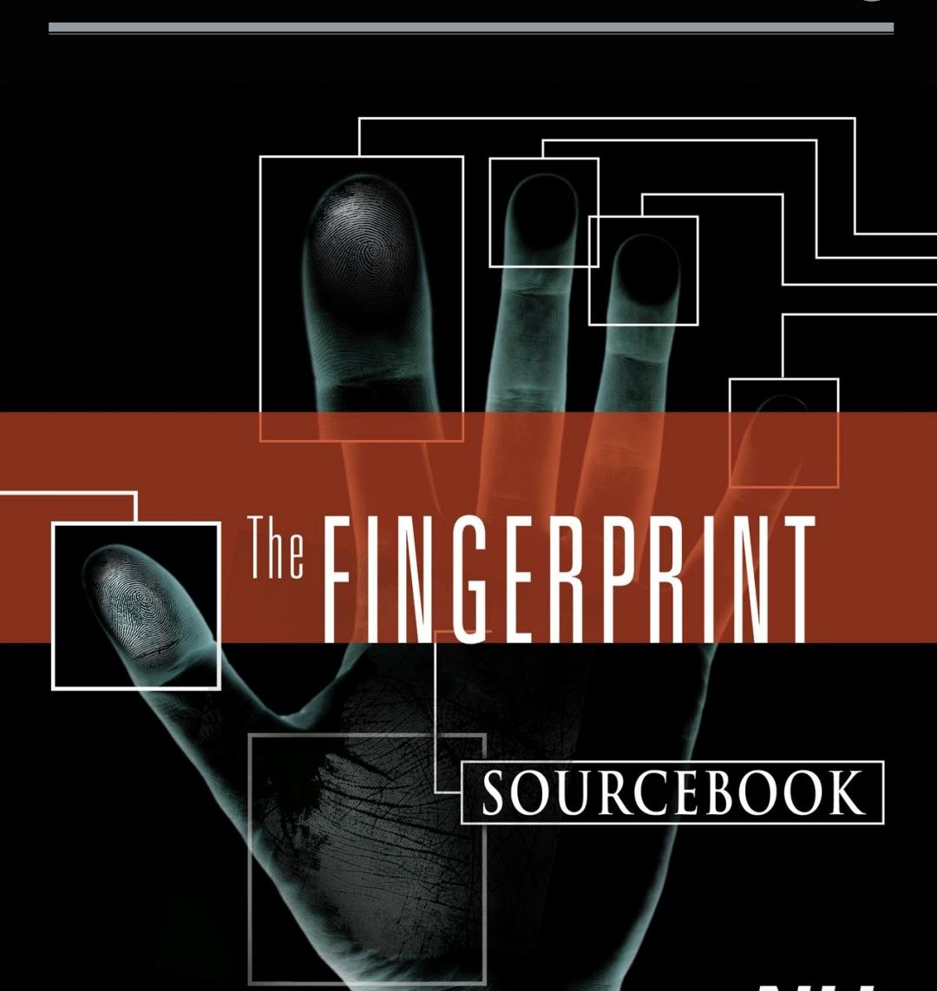
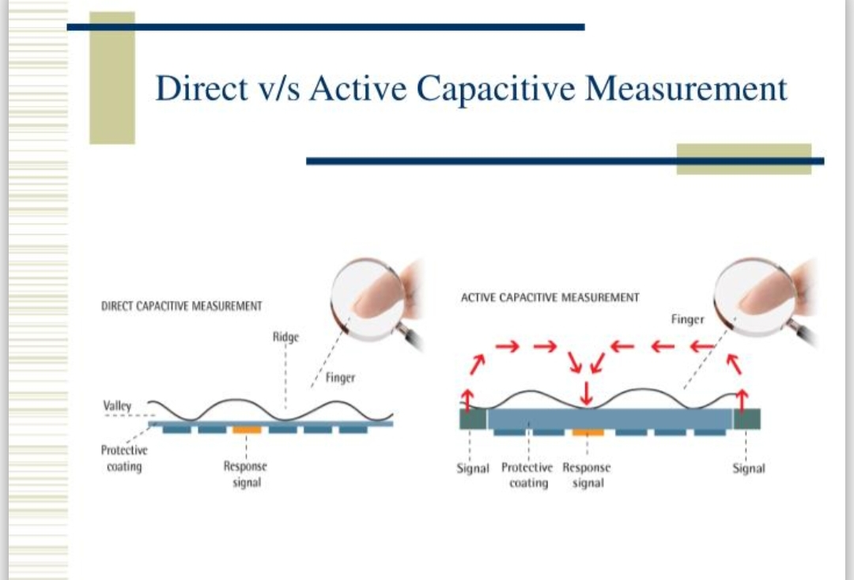

Slide 33


